Slide 1
Introduction to NoSQL Databases
Introduction to NoSQL databases and MongoDB (Day 3)
Notes:
Photo by Mark König on Unsplash

Slide 2
Lesson Outcome
By the end of today, you should be able to:
Understand the basics of NoSQL databases and their role in backend development
Explain what NoSQL is and its importance in data management
Create and query MongoDB using MongoDB Compass

Slide 3
Recap: What is a SQL database?
A SQL database is a relational database that stores data in tables and rows. It's a highly structured database and rule-based, allowing precise and efficient data management.

Slide 4

Recap: Introduction to SQL
SQL (Structured Query Language): A standard language for interacting with databases.
Purpose: Retrieve, insert, update, and delete data stored in a database.
Universality: Used across various database systems (MySQL, PostgreSQL, SQLite, etc.).
Design: Highly structured and rule-based, allowing precise and efficient data management.

Slide 5
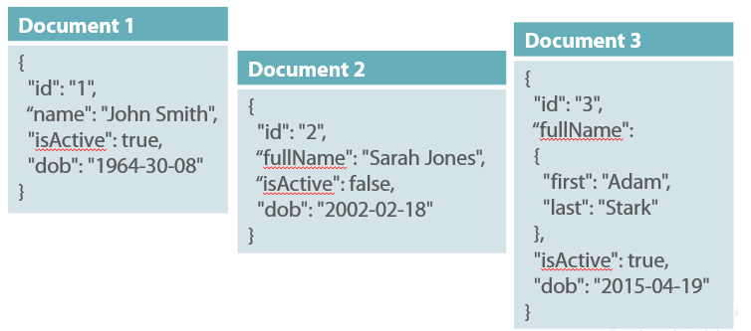
What is a NoSQL database?
Not only SQL (NoSQL) database is a non-relational database that stores data in documents, key-value pairs, or graphs. It's a flexible database and schema-less, allowing for quick and iterative development.

Slide 6
What is the difference between SQL and NoSQL databases?
SQL databases are relational, NoSQL databases are non-relational.
Let's use an example to illustrate this difference. Imagine we have a database of users and their addresses.
In a SQL database, we would have two tables: one for users and one for addresses. The users table would have a unique ID for each user, and the addresses table would have a unique ID for each address. The addresses table would also have a column for the user ID, so that we can link each address to a user.
In a NoSQL database, we would have one collection of users, and each user would have an array of addresses. The addresses would be embedded in the user document.

Slide 7
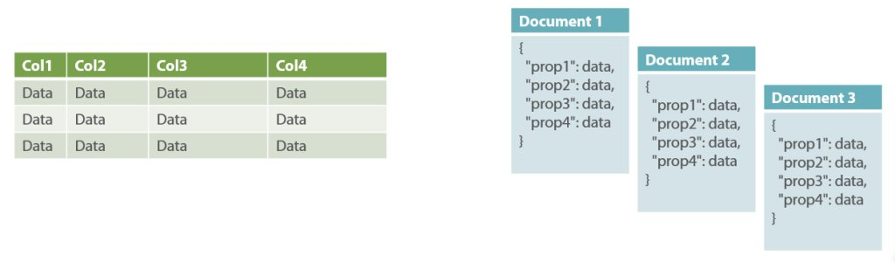
What is the difference between SQL and NoSQL databases?

Slide 8
SQL Terms vs NoSQL Terms
SQL
Database
Table/Entity
Row/Tuple/Record
Column/Field/Attribute
Primary Key (PK)
NoSQL
Database
Collection
Document
Field
Object ID (OID)

Slide 9
Then which one should I use?
There is no right answer for this. It obviously depends on your use case. If you have a highly structured data, and you need to perform complex queries, then SQL is the way to go. If you have a flexible data structure, and you need to perform simple queries, then NoSQL is the way to go. Also keep in mind that SQL has been around for a long time, and it's a mature technology meaning that there are a lot of tools and resources available. NoSQL is a relatively new technology, and it's still evolving. It's also worth mentioning that SQL is a standard language used for relational databases, and it is consistent across SQL database management systems. NoSQL databases, on the other hand, encompass various non-relational databases, and their query languages or APIs may vary.

Slide 10
Examples of NoSQL databases
MongoDB
CouchDB
RavenDB
Cassandra

Slide 11
What is MongoDB?
MongoDB is a document-oriented NoSQL database. It stores data in JSON-like documents with dynamic schemas, meaning that you can create records without first defining the structure, such as the fields or the types of their values. This makes MongoDB very flexible and adaptable to change.

Slide 12
Creating a MongoDB database
Make sure Docker is installed on your machine.
Open your terminal or command prompt and run the following command to create a MongoDB database locally:
docker run --name mongodb-local-server -p 27017:27017 -d mongo:latest
(If you encounter any permissions error, use sudo before the command (only for Linux and Mac).
To check if the MongoDB server is running, run the following command:
docker ps
This will display a list of running Docker containers. Make sure you see the container named mongodb-local-server with the status Up.
Additionally, you can install MongoDB Compass, which is a GUI tool for MongoDB. MongoDB Compass allows you to connect to your MongoDB database and view the data in it.

Slide 13
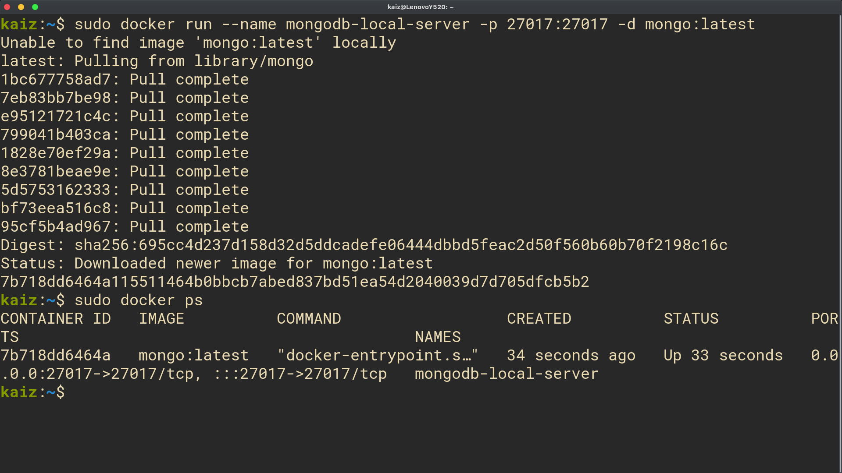
Creating a MongoDB database

Slide 14
Connecting to a MongoDB database using MongoDB Compass
Open MongoDB Compass and click "New Connection."
Enter this in the URI field: mongodb://localhost:27017
Click "Connect."
MongoDB Compass will connect to your database. Explore and manage your data using the GUI.

Slide 15
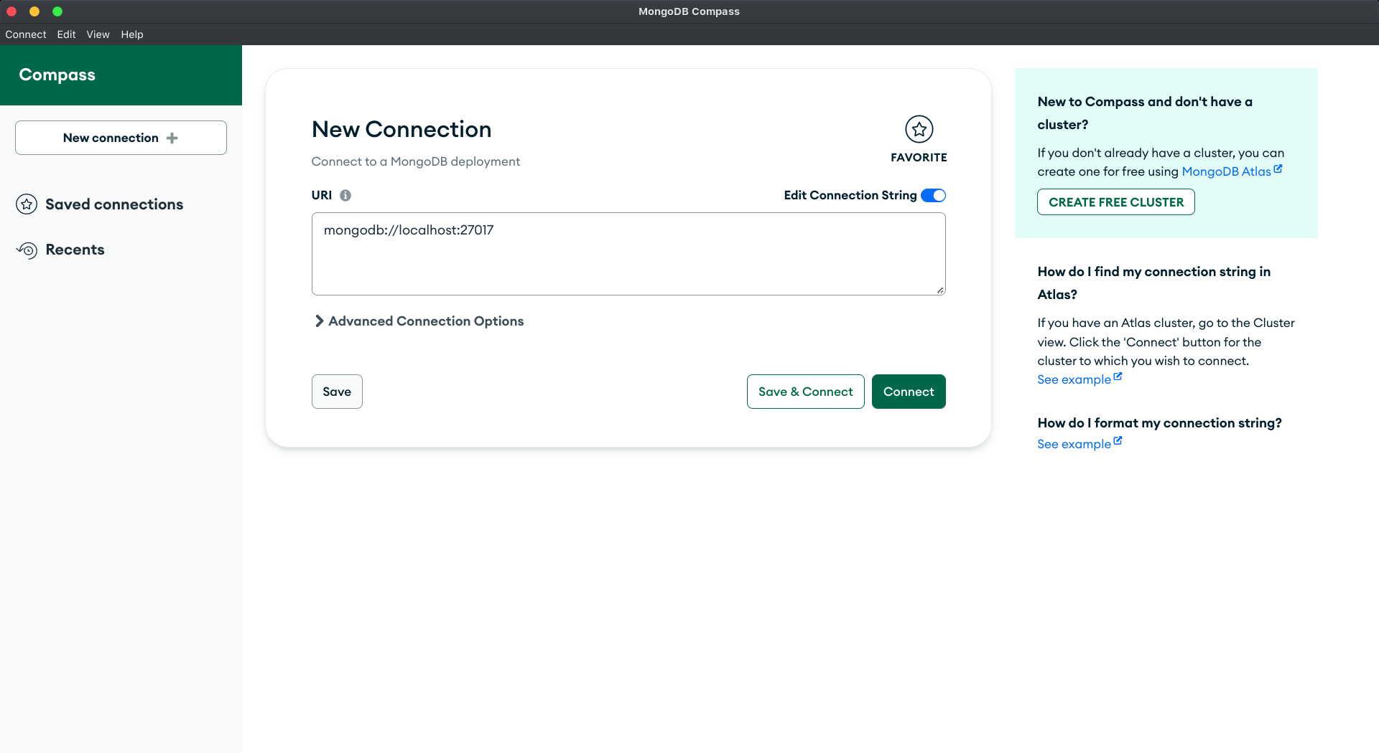
Connecting to a MongoDB database using MongoDB Compass

Slide 16
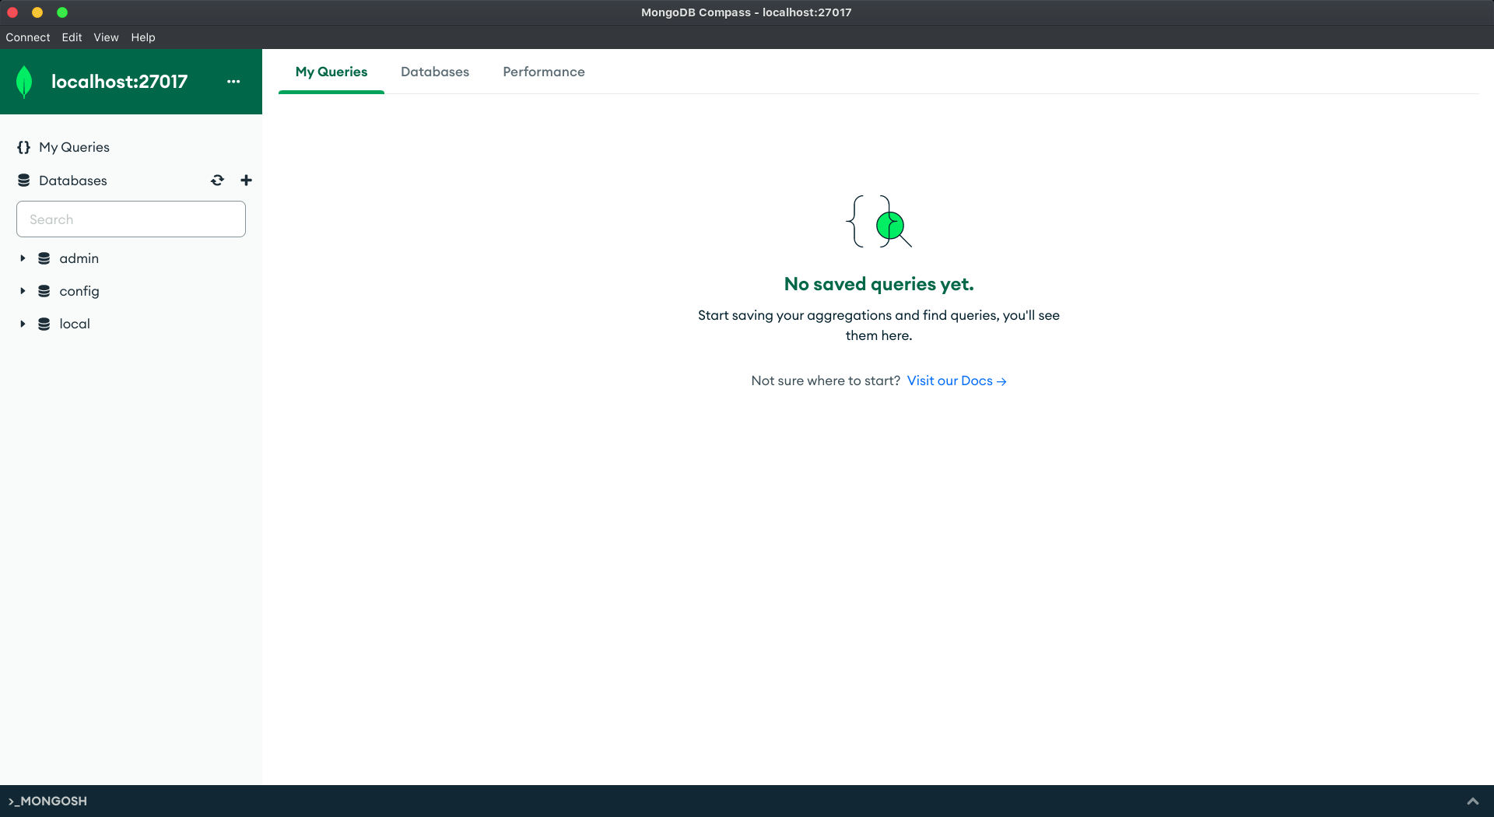
Connecting to a MongoDB database using MongoDB Compass

Slide 17
Connection String
A connection string is a string that specifies information about a data source and the means of connecting to it. It is passed in code to an underlying driver or provider in order to initiate the connection. For example, the connection string template for MongoDB is
mongodb://<username>:<password>@<host>:<port>/<defaultauthdb>

Slide 18
Connection String: Breaking it down
mongodb:// is the protocol prefix that indicates that the connection string is for MongoDB.
<username>:<password> is the username and password for the database. If you don't have a username and password, you can omit this part.
<host> is the host name or IP address of the server hosting the database.
<port> is the port number on which the database is listening for connections.
<defaultauthdb> is the name of the database to authenticate if the connection string includes authentication credentials in the form of username:password@. If you don't have a default authentication database, you can omit this part.
So our connection string is mongodb://localhost:27017. We omitted the username, password, and default authentication database because we don't have them.

Slide 19
Case Study: eWallet App
In this Code Along, we're going to build a database structure for the eWallet system using MongoDB. Here's the brief overview of the system:
Users can register and login.
Users can reload/pay through their wallet.
Users can view their transaction history.
Merchants can register and login.
Merchants can view their transaction history.
Merchants can receive money from users.
Since this is a just a first version, we don't need to worry about security and scalability. We just need to build the core features.

Slide 20
Q: Let's start by identifying the entities in our system.
How many entities do you see? What are they? What are their attributes?

Slide 21
Q: Let's start by identifying the entities in our system.
How many entities do you see? What are they? What are their attributes?
Users
Object ID
Name
Email
Phone Number
Merchants
Object ID
Company Name
Company Email
Phone Number
Users Transactions
Object ID
User Object ID
Type (Add/Deduct)
Timestamp
Amount
Merchant Transactions
Object ID
Merchant Object ID
Timestamp
Amount

Slide 22
Self Cover: NoSQL Databases Up until Assignment 3

Slide 23
Task of the day Your task for today is to create a database for a social media app in MongoDB. Here's the brief overview of the app:
Users information should contain their profile information such as their name, email, phone number, tags and so on. Tags should be an array of strings. Tags should contain/tell the user's preference.
Users can create/view/update/delete posts.
Users can follow other users.
Posts can be liked and commented by different users.

Slide 24
Take home tasks

Slide 25
Some homework 📚
Module Capstone Project ~ BookingApp

Slide 26
References
MongoDB Datatypes
Relational Databases vs. NoSQL Document Databases

